Slide 1

We want to perform an advanced causal questioning of the type:
“I want to achieve an objective while doing something with custom constraints. How?”

Slide 2


Scenario
Mr. Nicol Bolas wants to burn more calories because he has heard that, with age, body weight tends to increase.
He wants to set a regular walking plan because he knows that it can be beneficial for his health; however, he also does not feel comfortable walking for too long due to his age. He then resolves to walk to and from his workplace every day, as well as take similar walks on weekends.
Additionally, he has a particular knack for tennis, already has all the necessary equipment to practice it, and is tired of constantly trying new sports with his indecisive wife. Thus, he decides to play tennis exclusively, scheduling matches with his colleagues and friends during the week, believing it will help him stay in good shape.
He sets a goal for himself, but will this plan work? He asks FitBuddy for help.
Hi, Nicol! I understand that you want to lose weight, while only playing tennis and walking to and from work. Let’s see how it would go!

Slide 3
Name: Nicol Bolas
Sex: Male
Age: 61
BMI: 15.7
Resting Heart Rate: 68 bpm
Blood Pressure: 78/123 mm Hg
Smoking Status : Never
Health Condition: Diabetes
As a starting point, let’s assume the data above and the table below as the baseline for Mr. Bolas’ health and fitness status.
Also, let’s assume that the causal graph in the following slide accurately represents the causal relationships between the variables.
 | FITNESS |  |  | LIFESTYLE |  |  |  | HEALTH | RESULTS
 | Activity | Duration | Intensity | Daily Steps | Sleep Hours | Stress Level | Hydration Level | Average Heart Rate | Calories Burned (*1000) | Fitness Level
January | Swimming | 63 | Medium | 8949 | 7.16 | 6.67 | 2.41 | 114 | 8 | 0.88
February | Cycling | 56 | Low | 9585 | 7.22 | 5.52 | 2.51 | 115 | 9 | 2.34
March | HIIT | 75 | Low | 10386 | 7.17 | 5.25 | 2.47 | 115 | 10 | 4
April | Weight Training | 73 | High | 9534 | 6.97 | 4.71 | 2.4 | 121 | 17 | 6.08
May | Walking | 73 | Medium | 9244 | 7.1 | 5.8 | 2.5 | 114 | 9 | 7.91
June | Swimming | 67 | Low | 9002 | 6.7 | 6.39 | 2.6 | 115 | 12 | 9.67
July | Weight Training | 74 | Low | 7949 | 7.15 | 4.82 | 2.51 | 112 | 15 | 11.28
August | Cycling | 79 | High | 7786 | 7.12 | 5 | 2.64 | 113 | 17 | 12.68
September | Cycling | 58 | High | 7067 | 7.34 | 5.19 | 2.64 | 114 | 11 | 13.87
October | Dancing | 66 | Medium | 6655 | 6.97 | 4.5 | 2.51 | 117 | 16 | 14.99
November | Tennis | 59 | Medium | 7652 | 7.12 | 5.25 | 2.13 | 109 | 13 | 15.93
December | Dancing | 67 | Low | 7609 | 6.94 | 6.19 | 2.51 | 113 | 15 | 16.98

Slide 4
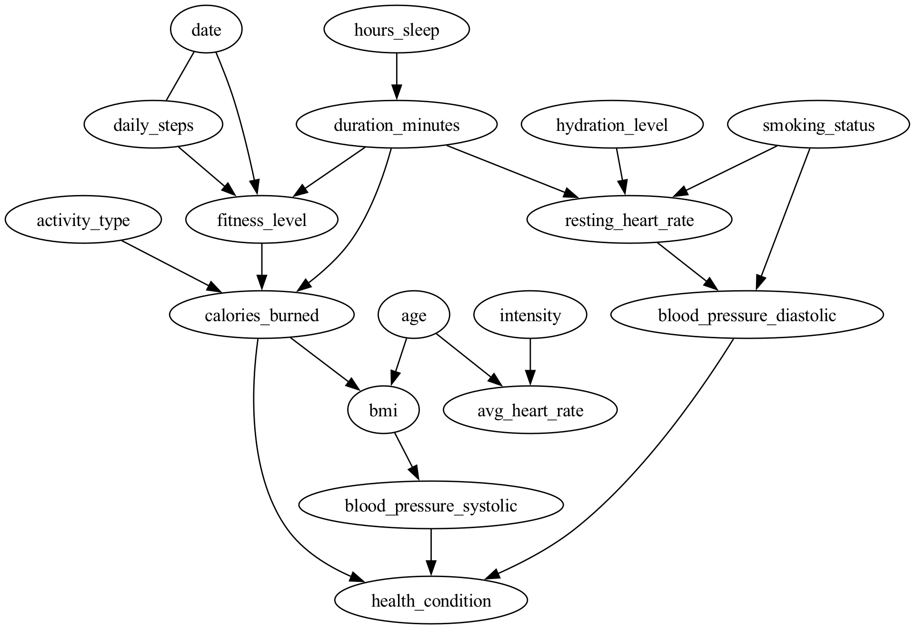

Slide 5
First, we set the desired constraints: playing tennis only, and walking to and from work.
Observing the graph, we can see some changes in the prospective amount of calories burned during the year;
These changes are minor and do not already prove a steady increase in the amount of calories burned;
In fact, if we compute the yearly average, we can observe that the average calorie consumption very slightly decreases from -0.53 to -0.51 (regularized values).
Great job, Nicol! However, I calculate that you would actually burn fewer calories with this behaviour.
Shall we find a solution together?

Slide 6
FitBuddy could then compute the causal influence of other variables on the variable calories_burned, as shown in the graph below, to suggest the best course of action.
Since we cannot manipulate the date, fitness level, or calories themselves, and since the hours of sleep have a negligible effect on the calories burned, what remains is to manipulate the duration in minutes of the training;
FitBuddy could either determine whether the user’s desired amount of training would be sufficient to reach the set goal or suggest an optimal amount of training to achieve it.
Nicol, would you like to set a level of training you are comfortable with and find out how close we can get to your objective?
Or would you prefer me to suggest the optimal amount of training to achieve your desired goal?

Slide 7
Case 1: The user sets a desired amount of training, and FitBuddy responds to determine if it would be sufficient to achieve the goal or how close they are to reaching it.
Increasing the training time by a comfortable amount, we can observe a significant increase in calories burned from the graph;
In fact, the prospective average calorie consumption increased from -0.53 to -0.24 (regularized values);
Hypothesizing an objective of -0.2, the user could decide to push a bit further or be satisfied with the results.
You are doing great, Nicol!
With this effort, you are close to your objective!
Would you like to pursue this plan, or should I suggest the optimal strategy?

Slide 8
Case 2: FitBuddy suggests the optimal amount of training to reach the set goal.
We can compute the optimal amount of training to at least satisfy the objective, or we can compute it to get as close as possible to such a value.
Here we present the first option.
We iteratively increase the value of duration_minutes by small increments until we find the first value of calories_burned that is greater than or equal to the set goal, and then provide the answer.
This is how much you should be training to reach your goal, Nicol!
Do you feel comfortable doing that? Or should we stick to doing your best?

Slide 9
This is a Proof of Concept
Please, don’t train 20 hours a day or walk 50km, if I now suggest so!
This study aims to show that the causal analysis approach can work for providing personalised health and fitness suggestions to users via interaction with an AI agent;
At this stage, it intentionally ignores some constraints, such as precautionary and realistic human limits;
Given the synthetic and relatively limited nature of the data available, the suggestions currently need to be simple and straightforward;
With larger and more realistic datasets, along with increased domain knowledge and development time, the previous limitations could be realistically overcome, leading to an efficient and functional approach.

